Slide 1
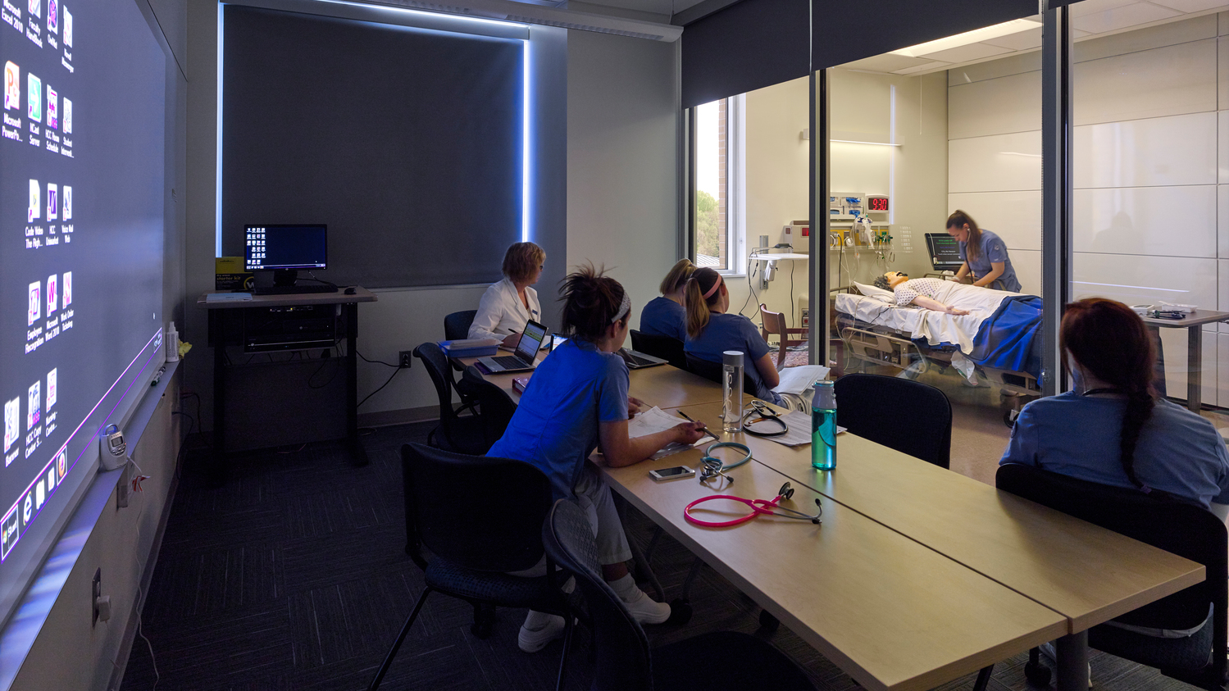

July 17, 2020
Nursing Simulation:
What We Have
Learned from
the Pandemic

Slide 2
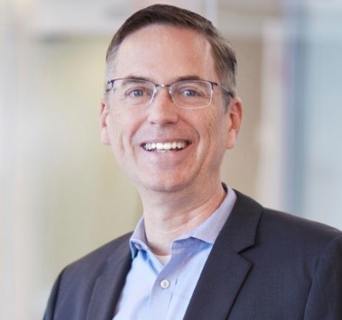
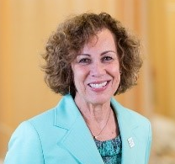
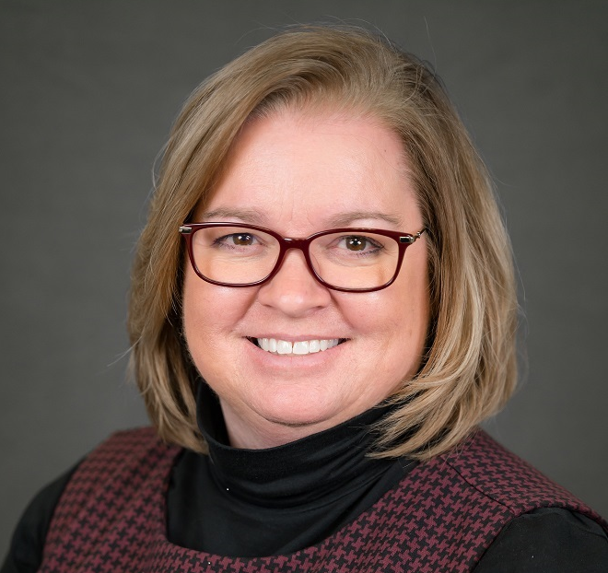

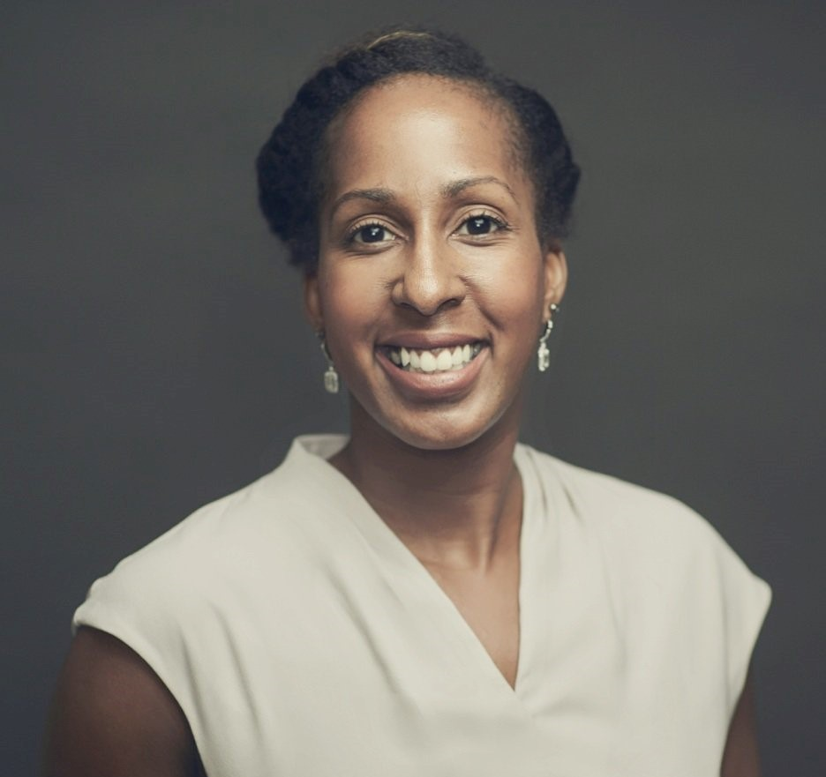
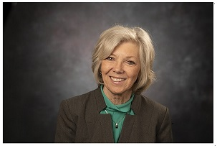
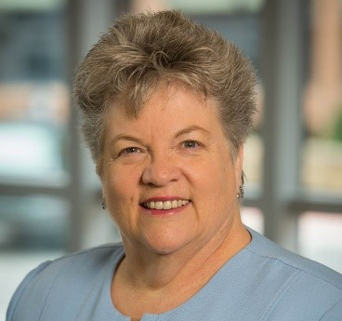
NURSING SIMULATION:
What We Have Learned from the Pandemic
PAUL LUND
Hord Coplan Macht
PAMELA R. JEFFRIES
George Washington University School of Nursing
CRYSTEL L. FARINA
George Washington University School of Nursing
PAMELA SLAVEN-LEE
George Washington University School of Nursing
KELLIE BRYANT
Columbia University School of Nursing
SHARON DECKER
Texas Tech University Health Sciences Center
CAROL F. DURHAM
The University of North Carolina at Chapel Hill

Slide 3

A Dean’s Perspective
During this unprecedented time teaching, planning, and leading during a global pandemic, these are lessons learned:
Pamela R. Jeffries
PhD, RN, FAAN, ANEF
Professor and Dean
George Washington University School of Nursing
Lesson #1: The Necessity of Communication and Transparency
Lesson #2: The Value of Collaboration
Lesson #3: Change can occur quickly when needed
Lesson #4: Greater Possibilities and Opportunities Together
Lesson #5: Art of creativity and out-of-the-box thinking
Lesson #6: An attitude of gratitude

Slide 4

Timely and Accurate Messaging
Mission Critical Information
  Faculty
  Staff
  Students
Communication Tracker
  Sent from who, to who, on what date
  Program or track level follow up needed
Anticipate Questions
  Equip leadership with consistent answers
  FAQ documents
Pamela Slaven-Lee
DNP, FNP-C, FAANP, CHSE
Clinical Associate Professor and Senior Associate Dean for Academic Affairs
George Washington University School of Nursing

Slide 5


Simulation
  Focus on competency rather than fidelity
  Consider pedagogy and desired learning outcome
  Realistic and evidence based evaluation methods
Communication
  Do not assume the message was received and/or understood
  Clarify the intent – edit the words to match the intent
  Practice run before student forums
  Multiple methods of communication
  Filter of anxiety
LESSONS LEARNED

Slide 6

1
2
3
Kellie Bryant
DNP, WHNP, CHSE
Executive Director of Simulation and Assistant Professor
Columbia University School of Nursing
Adaptability and being comfortable with the unknown
Importance of preparing our students for covid-19
Innovative uses of video conferencing software

Slide 7
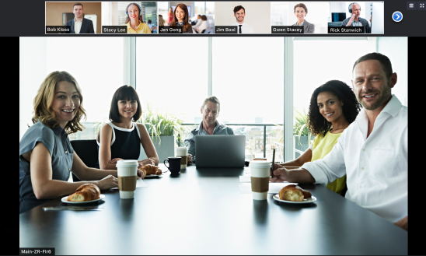
INFECTION PREVENTION
Personal Protective Equipment (PPE)
COVID 19

Slide 8
Didactic lectures
Screen based simulation programs
Demonstration and review of skills
Additional Slide Template if Desired

Slide 9
Telehealth Standardized Patient Scenarios
Additional Slide Template if Desired

Slide 10
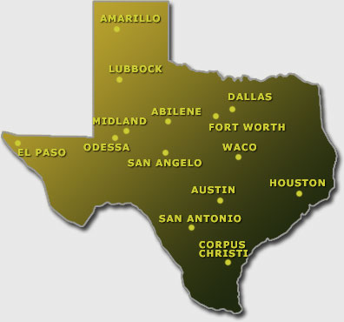


Challenges
  Multiple campuses, centers, sites
  Multi-modality
  Interprofessional in scope
Think “outside –the-box” - Flexible
  Accommodate change
    Modifying modalities
    Workflow
Communication
  Stay connected
Fiscal Responsibility
  ROI - Utilization
Sharon Decker
PhD, RN, FSSH, ANEF, FAAN
Associate Dean for Simulation, Professor in the School of Nursing, Executive Director for TTUHSC Simulation Program
Texas Tech University Health Sciences Center

Slide 11

Challenges Provide Opportunities
  Working with industry
  Online consultation internationally
  Research (Questions to address?)
    “What constitutes “simulation” in the virtual world?
    “What is the impact on the learners skills development and competencies when these are taught online?
    What is the right mix (percentage) of virtual (online) to in-person simulation-based activities?

Slide 12




Remote training of psychomotor skills
What? and How?
Carol F. Durham
EdD, RN, ANEF, FAAN, FSSH
Professor, Director of Interprofessional Education & Practice and Director of Education-Innovation-Simulation Learning Environment
The University of North Carolina at Chapel Hill
LOGISTICS
  Haptics
  Staging and storage
  Dishwashers – who knew?
RETURN TO LAB
  Decreasing student density
  Impact on workload and timeline
VIRTUAL CLINICAL
  Importance of Messaging
  Critical thinking
  Thriving
Disruptive Innovations – What will we keep?

Slide 13
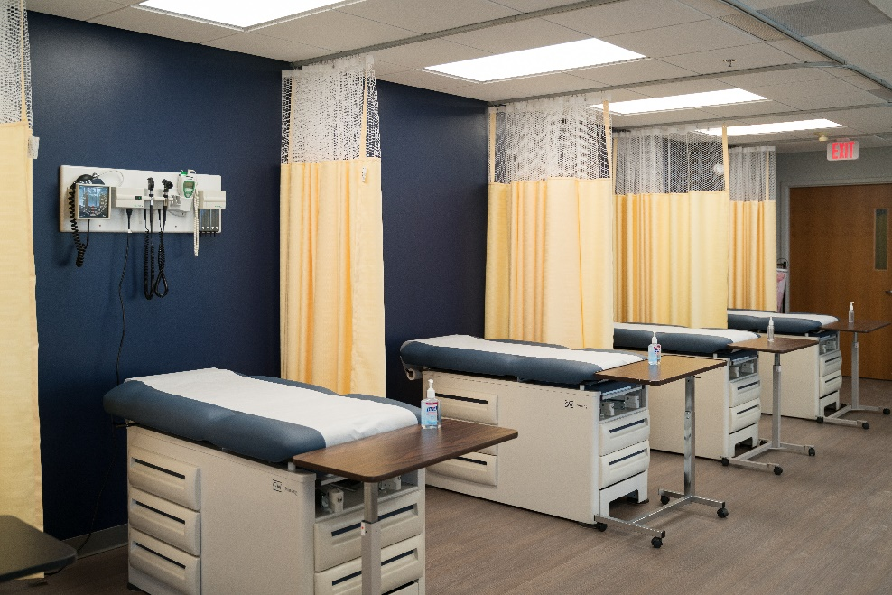



Flexibility
Crystel L. Farina
PhD(c), RN, CNE, CHSE
Assistant Professor, Director of Simulation and Experiential Learning
George Washington University School of Nursing
ROOMS
SPACE
FURNITURE

Slide 14
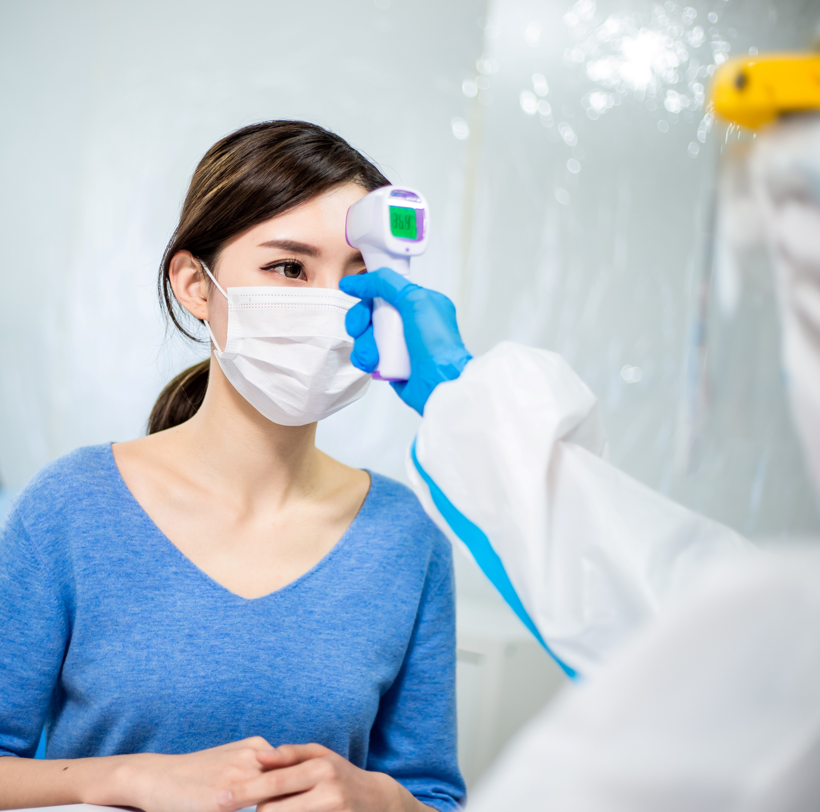
Operationalizing Screening for COVID-19
  Question surveys
  Thermometers
  Qualtrex
  QR Codes
1
2
3
4

Slide 15
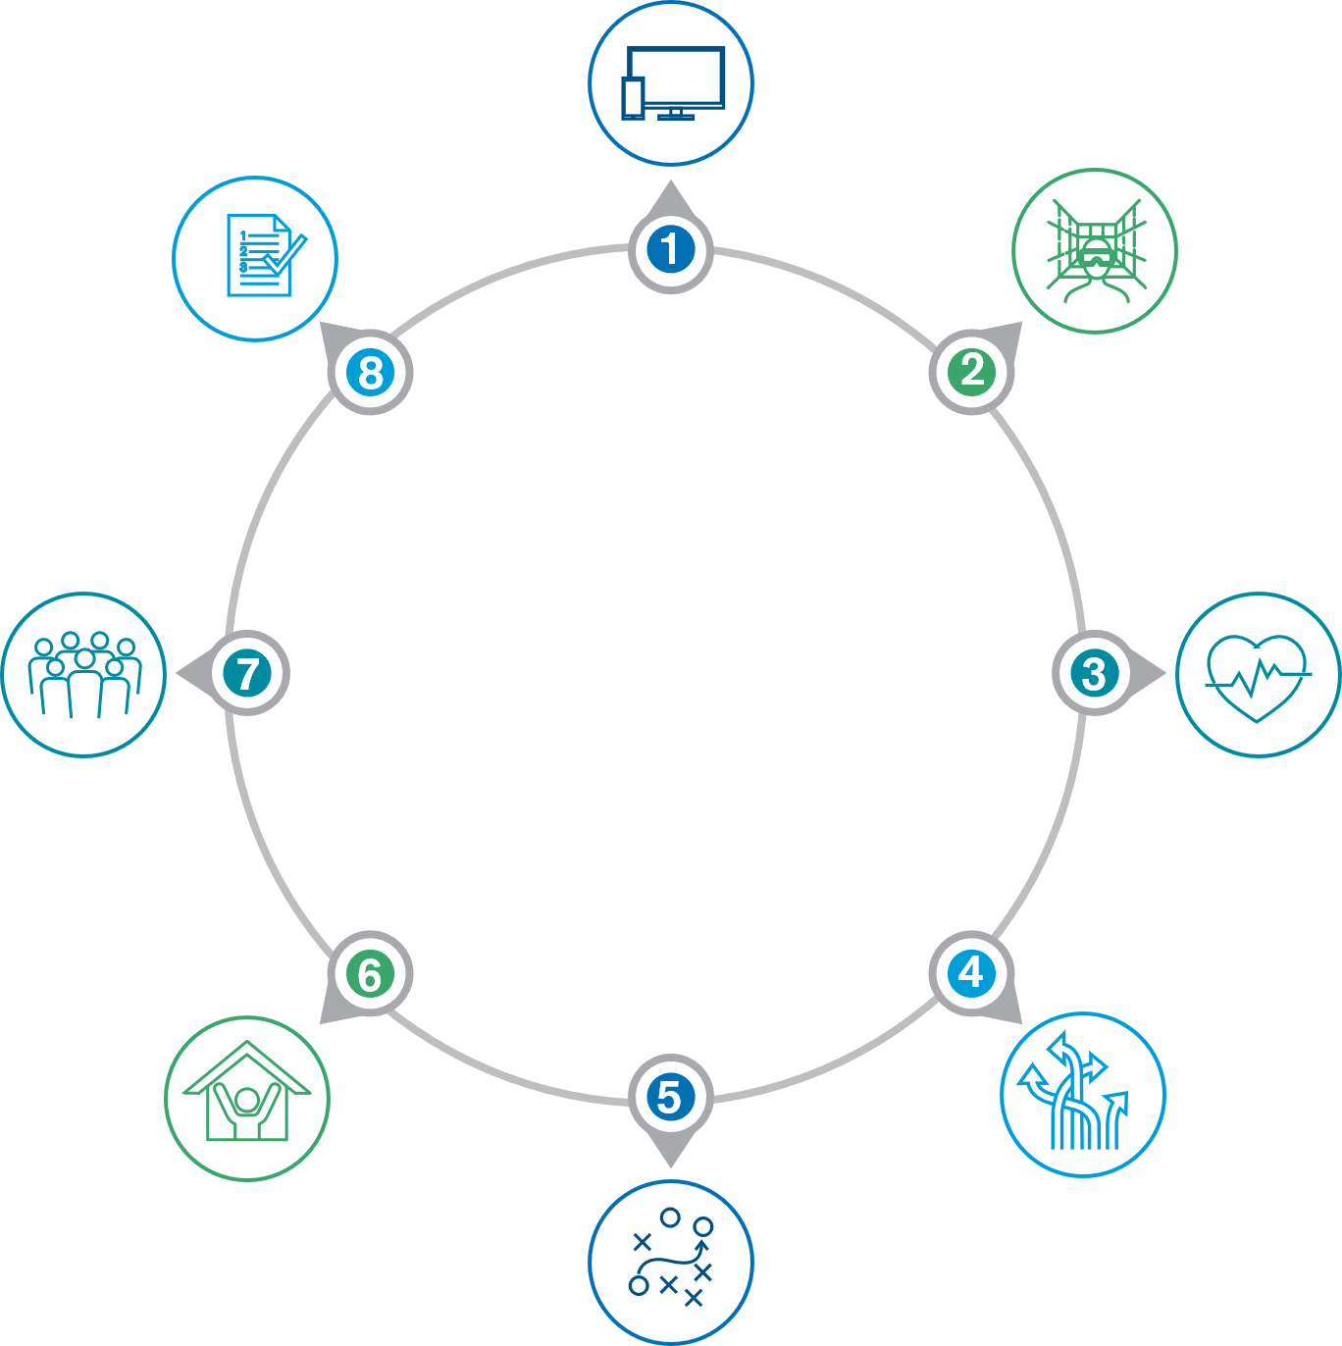

Virtual content creation
Storage, PPE, shipping, manikins
Haptics for fully immersive VR experience
8
FUTURE
TRENDS
Real patient / human unpredictability
Content creation spaces &
maker spaces
Paul R. Lund
AIA, LEED AP BD+C
Principal
Hord Coplan Macht
More collaboration & small spaces
huddle rooms, conference rooms, pods/carrells
5 year growth VR / AR & AI
Multipurpose space conversion Different uses – simulation, interactive group experiences, event, experimental layouts, etc.

Slide 16
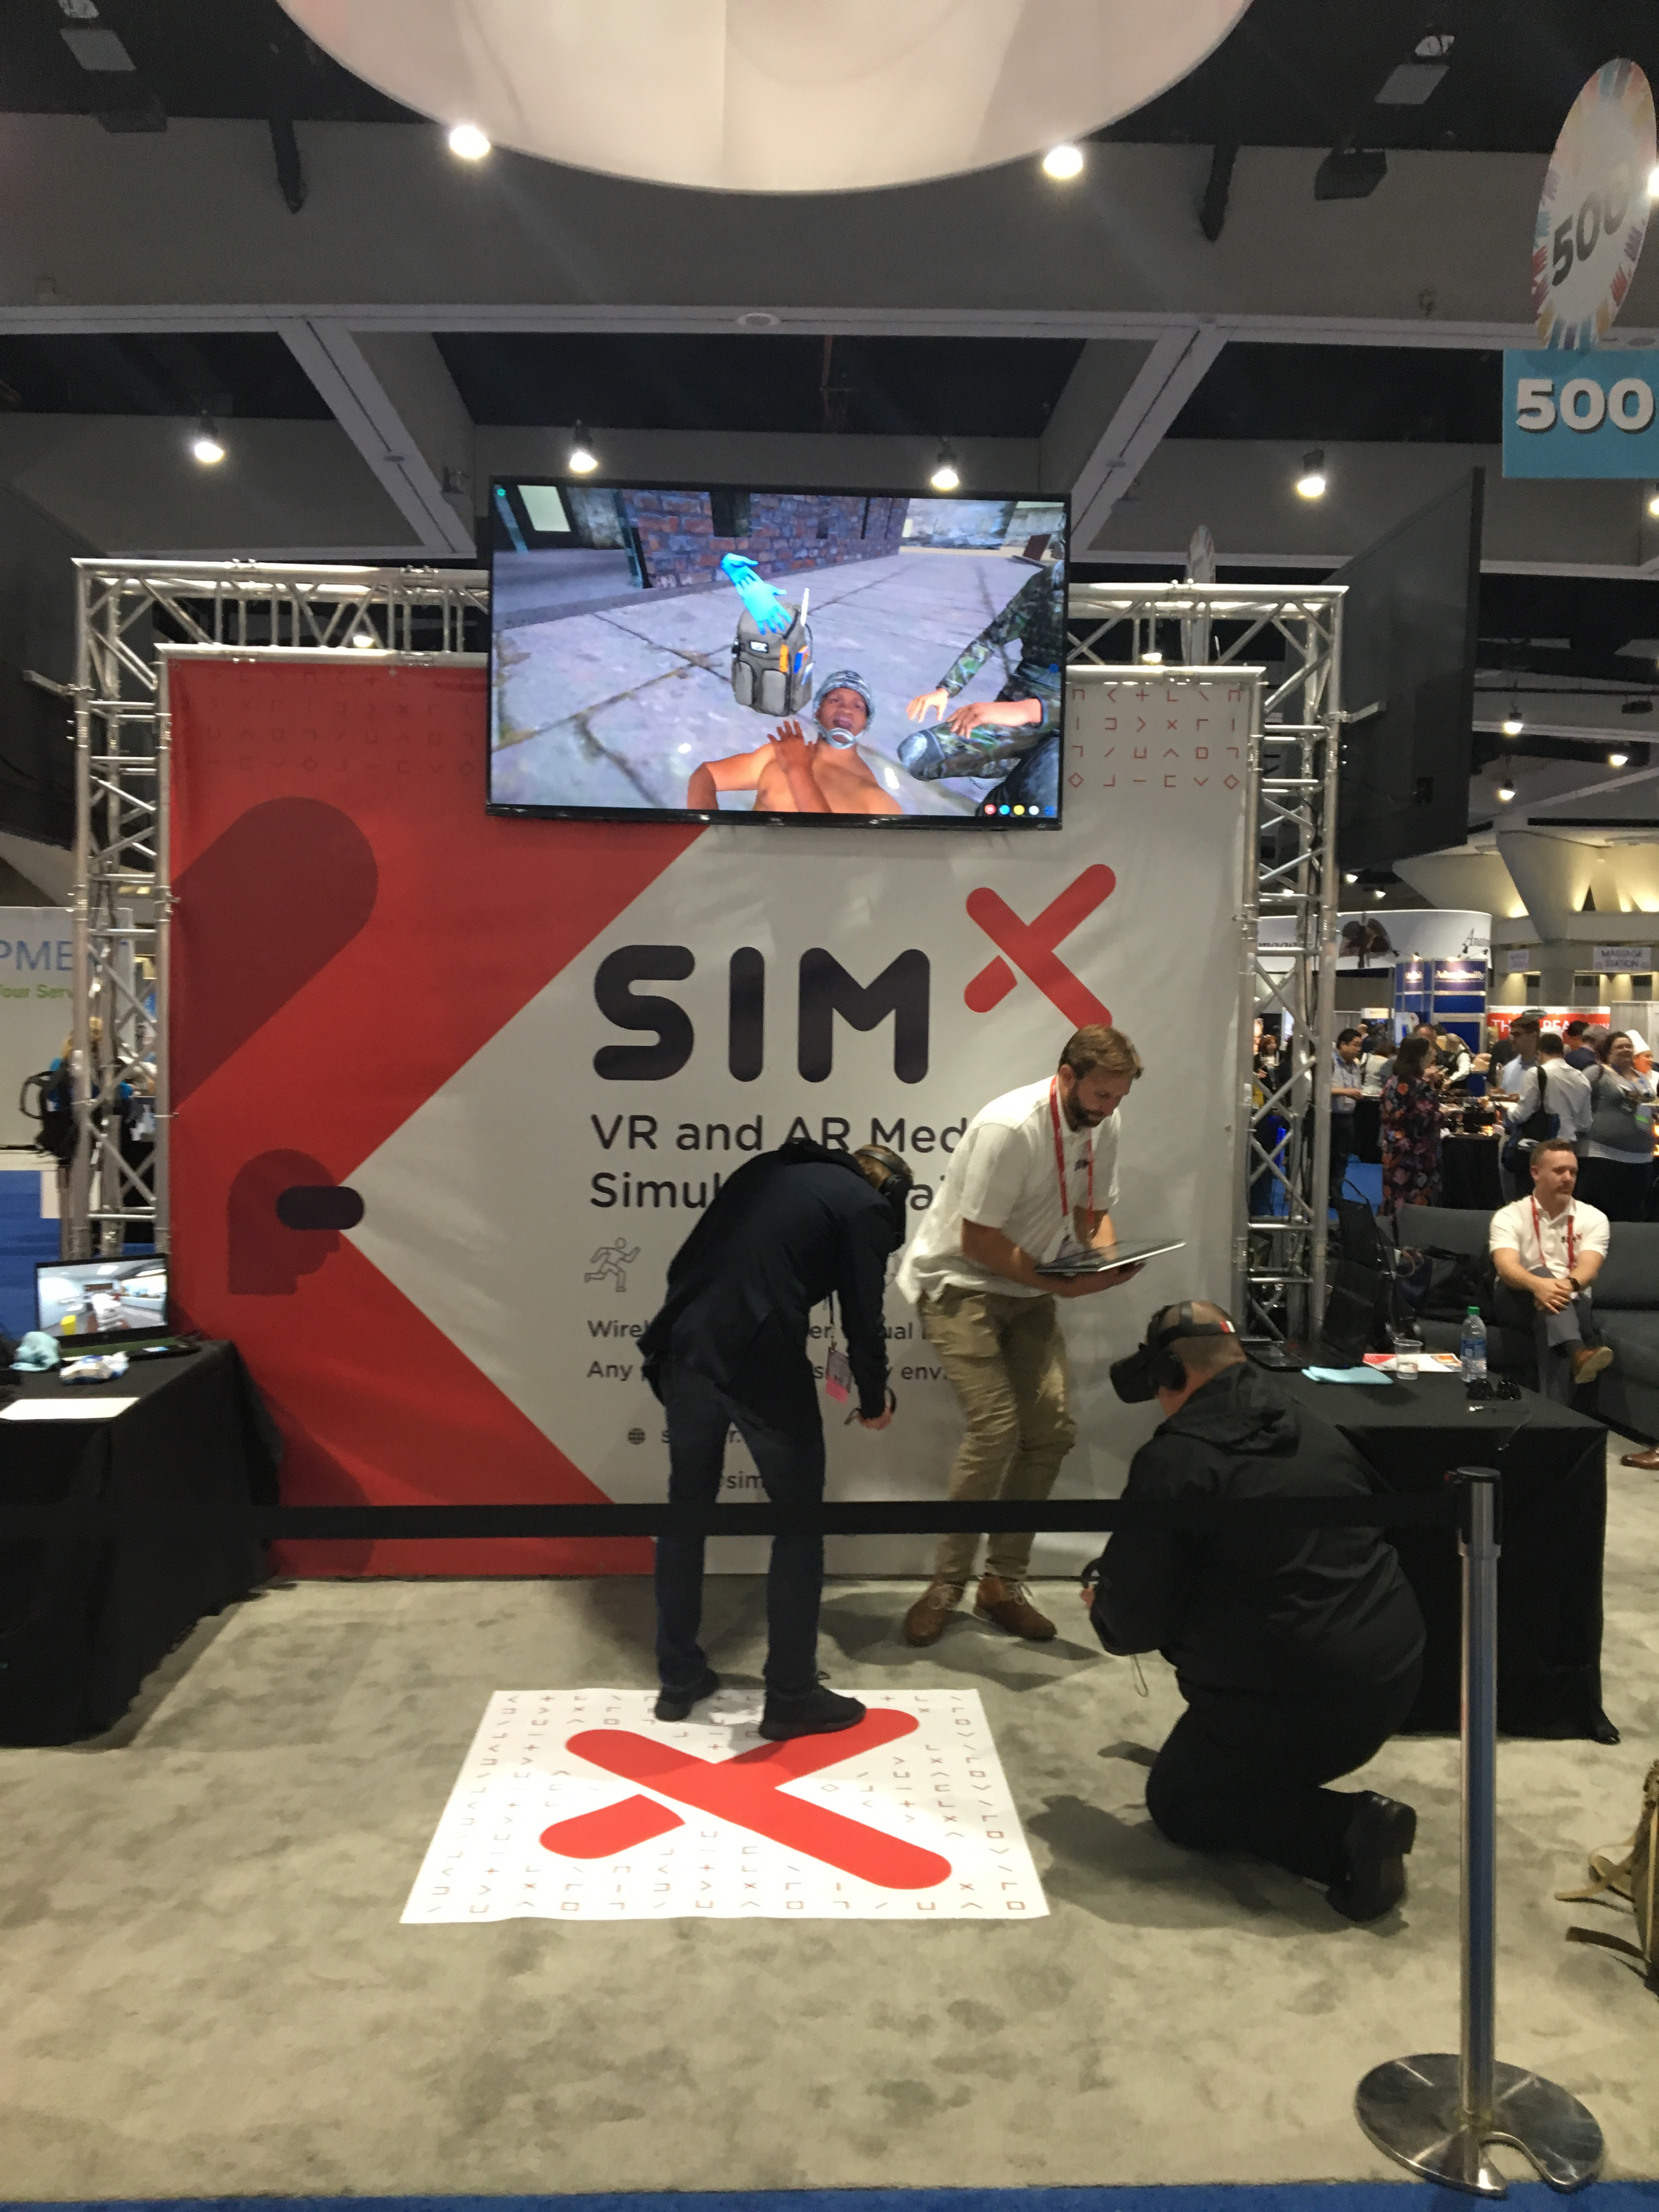
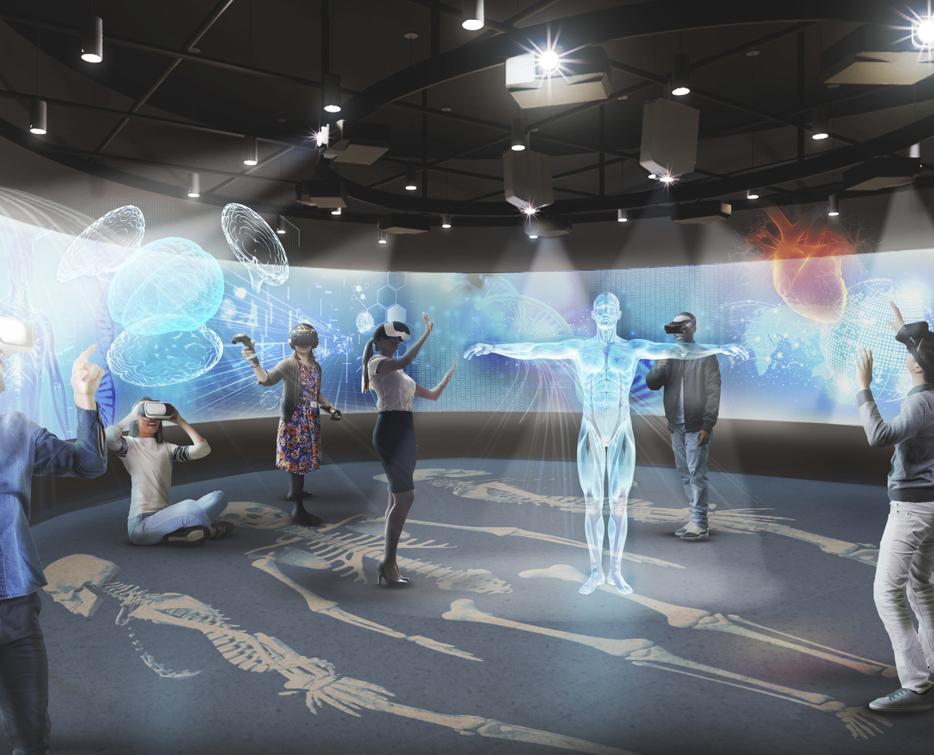
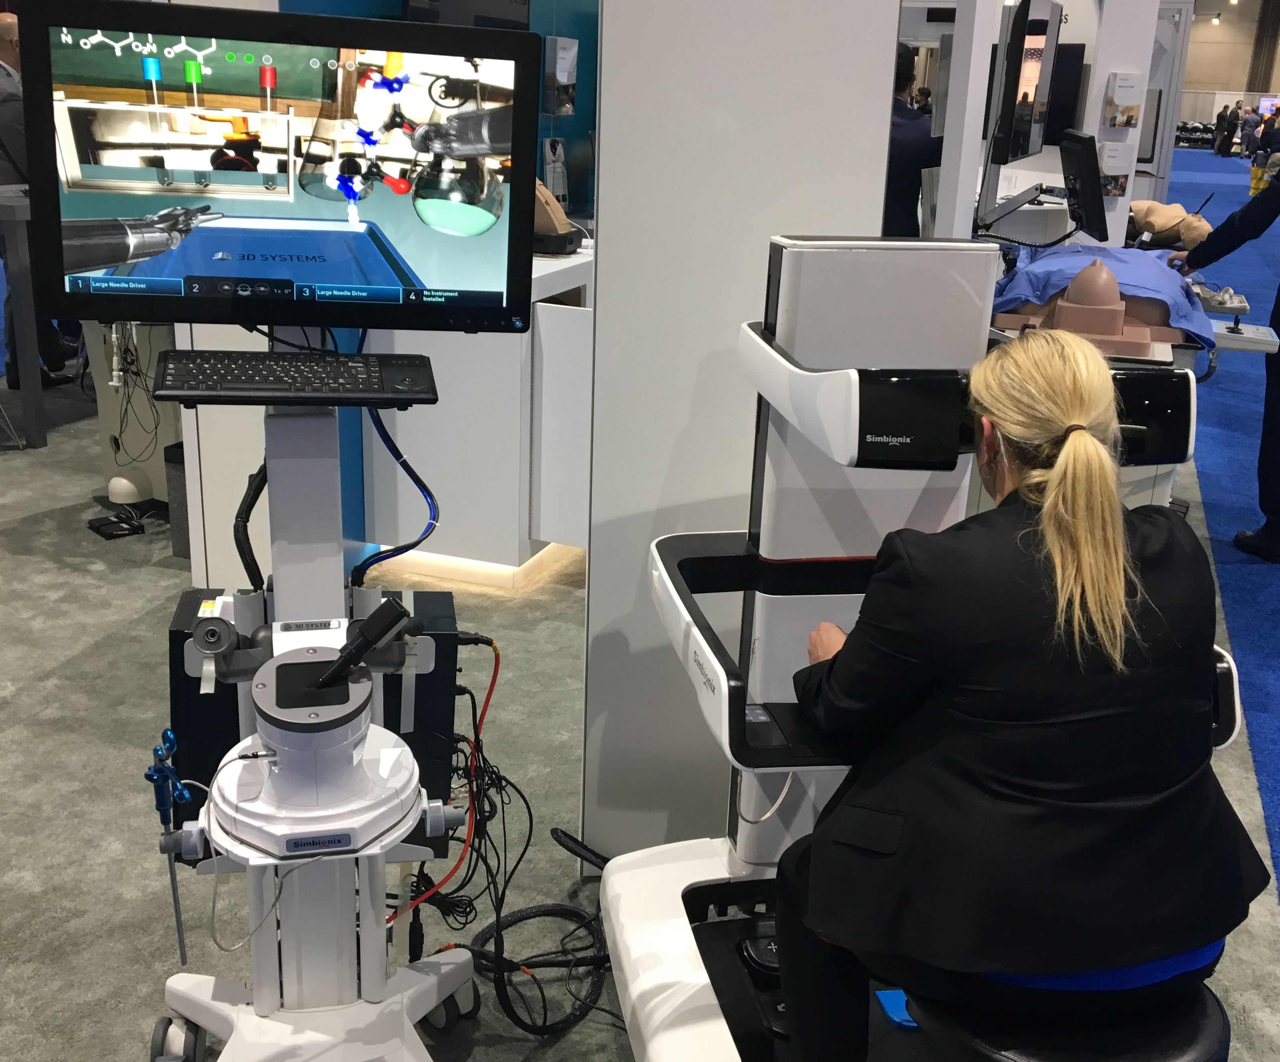

Slide 17
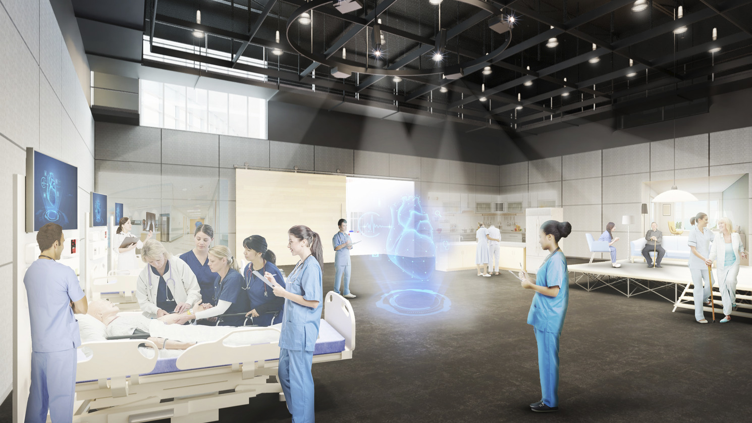

Slide 18
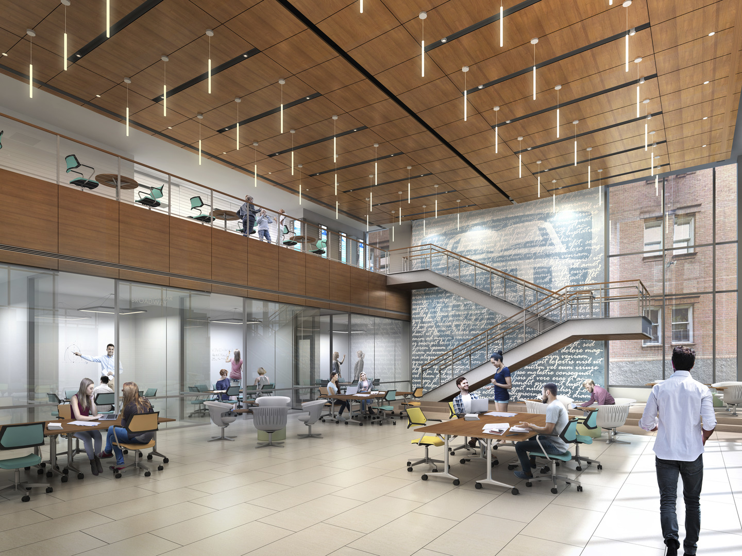
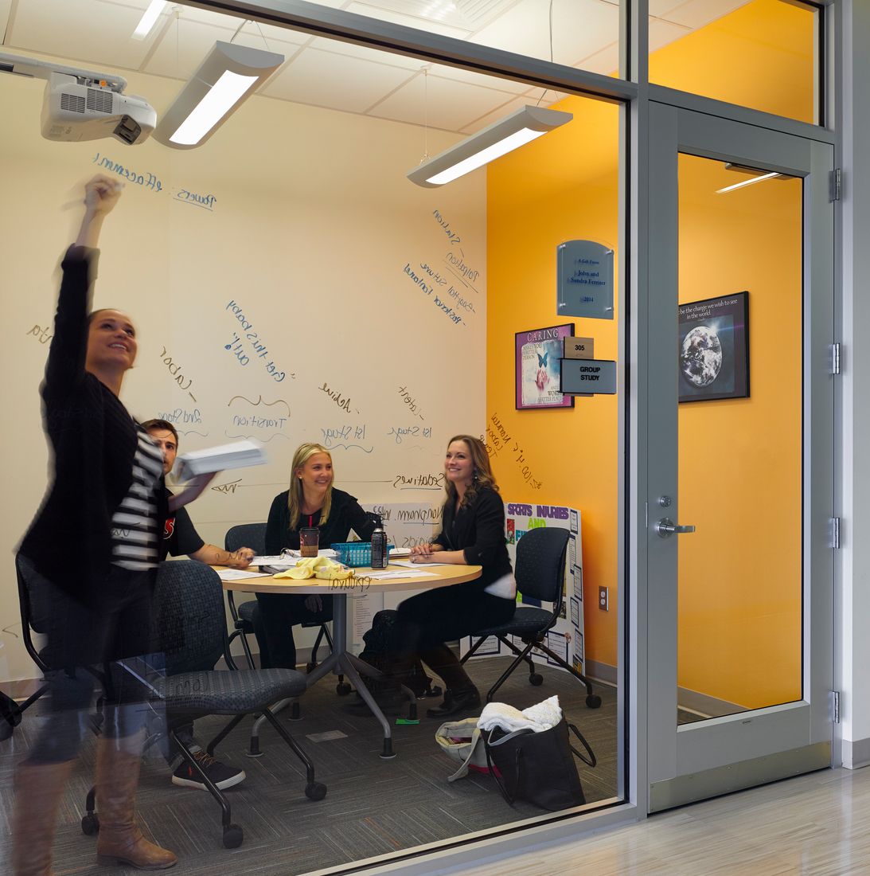
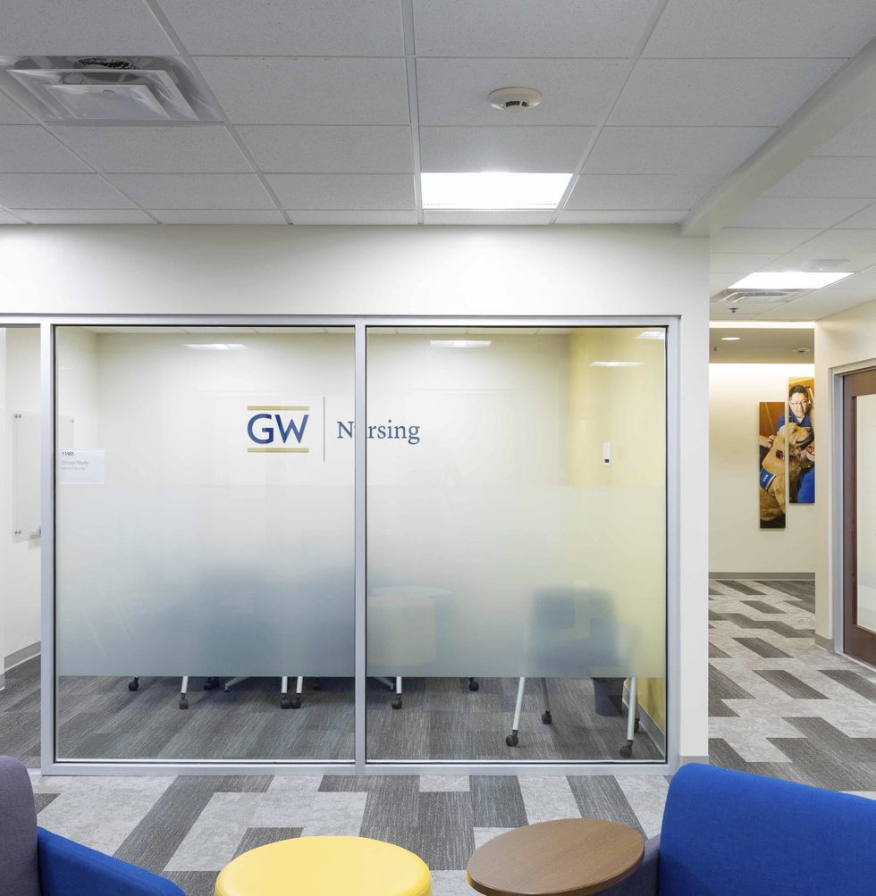

Slide 19
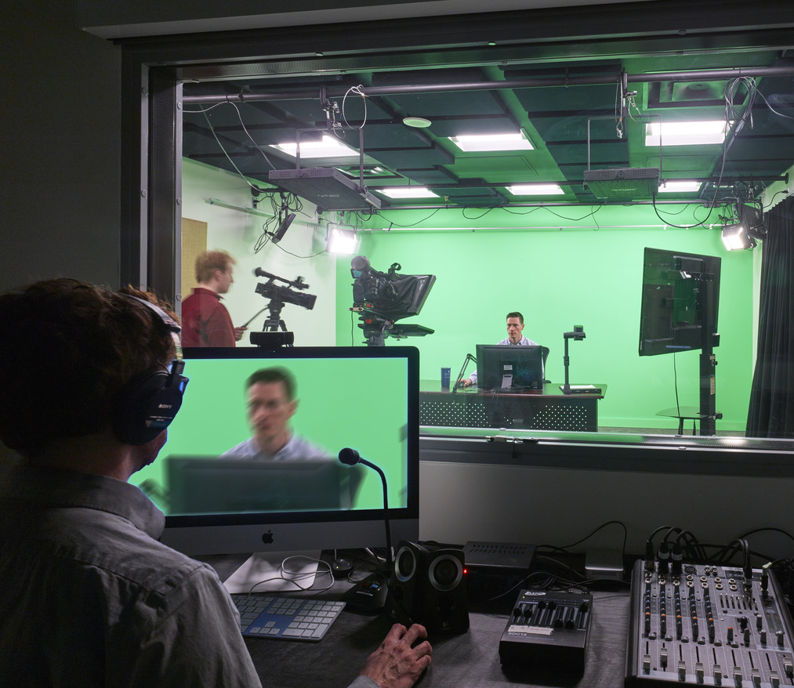
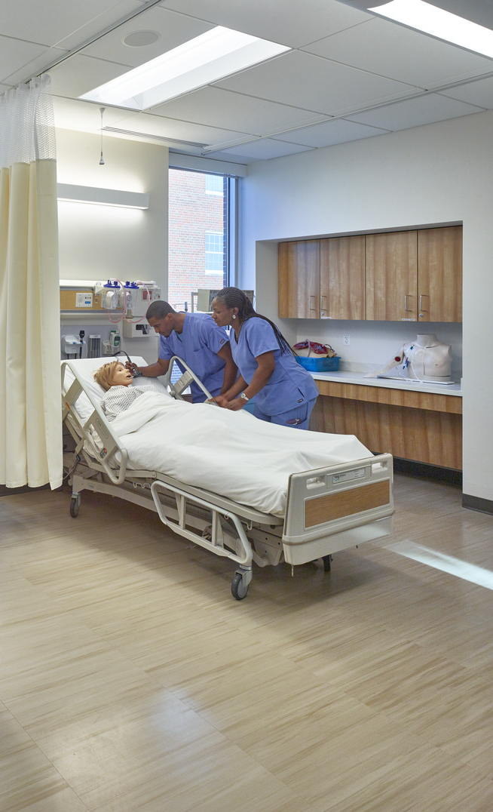

Slide 20

Nursing Simulation:
What We Have Learned from the Pandemic
Questions
& Answers

Slide 21
NURSING SIMULATION:
What We Have Learned from the Pandemic
PAUL LUND
Hord Coplan Macht
202.552.7615
plund@hcm2.com
PAMELA R. JEFFRIES
George Washington University
School of Nursing
202.994.8429
Pjeffries@email.gwu.edu
CRYSTEL L. FARINA
George Washington University School of Nursing
571.553.0115
cfarina@email.gwu.edu
PAMELA SLAVEN-LEE
George Washington University
School of Nursing
571.553.6885
pamelaslavenlee@gwu.edu
KELLIE BRYANT
Columbia University
School of Nursing
212.305.2982
Kdb2146@cumc.columbia.edu
SHARON DECKER
Texas Tech University
Health Sciences Center
806-281-8044
Sharon.Decker@ttuhsc.edu
CAROL F. DURHAM
The University of North Carolina at Chapel Hill, School of Nursing
919.966.1753
carol_durham@unc.edu

